Slide 1
School Facility Program Update
County School Facilities Consortium
September 25, 2012
“To enrich the lives of California’s school children as stewards of the taxpayers’ commitment to education.”
Presenters:
  Lisa Silverman, Executive Officer
  Rick Asbell, Chief of Fiscal Services

Slide 2
Today’s Discussion
COE Apportionments & Funding
Priority Funding Round
Financial Hardship Review (Process Improvements)
Financial Hardship Re-Reviews
Audit Subcommittee
2

Slide 3
COE Apportionments
Total Amount Apportioned For the School Facility Program: $31.9 Billion
3

Slide 4
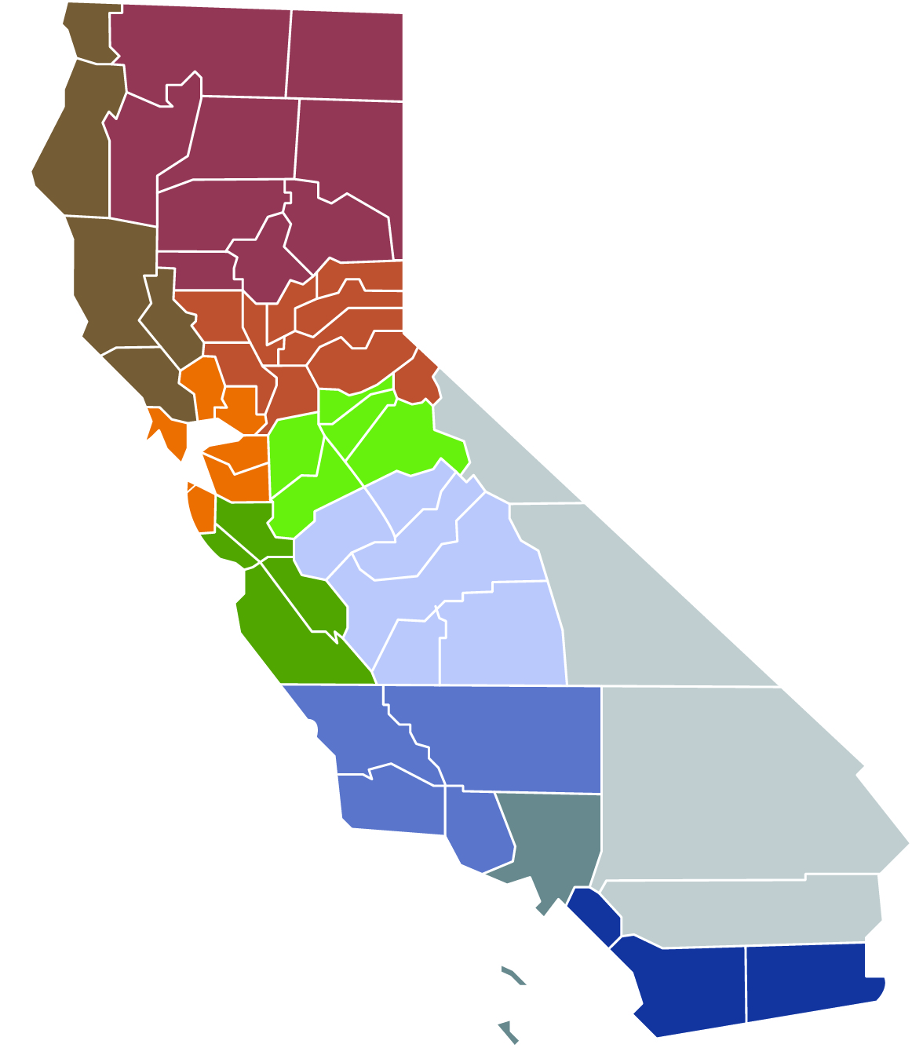
COE Funding by Region
Dollar figures represent all program totals.
$26.0 million*
60 CRs built
11 CRs modernized**
*
The classrooms (CRs) modernized represent the funding used for the facilities, which may not be on the classrooms but on other facility updates.
**
$49.6 million*
72 CRs built
3 CRs modernized**
$55.6 million*
78 CRs built
26 CRs modernized**
$30.0 million*
97 CRs built
66 CRs modernized**
$124.8 million*
174 CRs built
31 CRs modernized**
$54.8 million*
108 CRs built
36 CRs modernized**
$121.4 million*
263 CRs built
69 CRs modernized**
$50.7 million*
111 CRs built
33 CRs modernized**
$238.8 million*
556 CRs built
11 CRs modernized**
Totals
Funding $976.7 m
CRs built 2,023
CRs modernized 416
$127.0 million*
247 CRs built
120 CRs modernized**
$98.0 million*
257 CRs built
10 CRs modernized**
4

Slide 5
Priority Funding: Background
State Allocation Board (SAB) approved regulations at the May 25, 2011 SAB Meeting to expedite funding for projects that are ready to begin construction.
Two certification filing periods per year
  January and July
Each period has a 30-day certification submittal window
Projects on the Unfunded approvals list can participate
At the June 27, 2012 SAB Meeting, new regulatory amendments to the Priority Funding Process were approved
  Regulations are currently in the Public Comment Period with an end date of October 22, 2012
5

Slide 6
2013 Priority Funding Round Timelines
  Once Office of Administrative Law approves regulations:
First Filing Period:
  Request Filing Period from 1/9/13 to 2/7/13
  Eligible for Apportionments until 6/30/13
Second Filing Period:
  Request Filing Period from 5/8/13 to 6/6/13
  Eligible for Apportionments from 7/1/13 to 12/31/13
6

Slide 7
Priority Funding: What to Expect
Approximately $1 billion in remaining Bond Authority. In order to get these funds out into the community:
Sale of General Obligation Bonds by the State Treasurer’s Office
    Typically occurs in the Spring and in the Fall
    Cash available for apportionment
    September 25, 2012 Bond Sale
Apportionment made by the State Allocation Board
    Valid Priority Funding certification
    Funded according to original received date
Fund Release Authorization (Form SAB 50-05) must be submitted to the OPSC within 90 days
    If a valid form is not submitted, the project will be placed at the bottom of the Unfunded List
7
Notes:
If applicable, mention Bond Sale September 25- 1.6 Billion

Slide 8
Priority Funding: Current Round
Total Received: $637.6 Million, 119 Projects
Filing Period Began: July 11, 2012
Filing Period Ended: August 9, 2012
Certifications Expire: January 8, 2013
8

Slide 9
Financial Hardship Review – Process Improvements
Streamline the Financial Hardship (FH) Review process
Created FH Checklists to standardized documentation requested in a FH review
Two-tier FH review process
  Phase 1 – Review of qualifying criteria for FH status (COEs automatically qualify)
  Phase 2 – Review of available funds
Reminder Letters are sent to District/COE of upcoming deadlines for document submittal
On-Site and Conference Call outreach for District/COE is available
9

Slide 10
Financial Hardship Review Statistics
10

Slide 11
Financial Hardship Re-Review
Any SFP project on an unfunded list for more than 180 days must have a review conducted of a COE’s financial records to determine if additional COE funds are available as contribution to their project.
For the September 2012 Bond Sale, the OPSC will send letters to COEs who submitted a Certification Letter to participate in Priority in Funding
  Letter will ask for Financial Information based on the potential funds will be made available from the Bond Sale to the School Facility Program
FH Re-Review must be completed prior to a project receiving an apportionment.
FH Re-Review is only a review for additional funds.
The COE does not have to re-establish their FH status.
The OPSC will contact the COE for all documents required in an Unfunded FH Re-Review.
After a Re-Review is complete and the COE concurs with the finding they will be eligible to receive an apportionment.
11

Slide 12
Financial Hardship Webinars
Webinars to assist FH Districts and COEs
May 2011
  Overview of the FH review process
  Walk through of the Phase 1 and Phase 2 review process
  Discussed key documents needed: FH project worksheet, FH Fund Worksheets, and a worksheet breaking out RDA funds received by individual area
October 2011
  Background on FH Re-Reviews and Priority in Funding Rounds
  Documents needed
  Review of Available Funds
  FH Re-Review Findings Letter
Both webinars are available on the OPSC website.
12

Slide 13
Financial Hardship Team
For Assistance contact:
Steve Inman, Supervisor
916-375-4576 or steve.inman@dgs.ca.gov
Maria Gamino
916-375-2031 or maria.gamino@dgs.ca.gov
John Leininger
916-375-4610 or john.leininger@dgs.ca.gov
Jacqueline Shepherd
916-376-5119 or jacqueline.shepherd@dgs.ca.gov
Audrey Sims-Davis
916-376-3989 or audrey.simsdavis@dgs.ca.gov
13

Slide 14
Audit Subcommittee
Last meeting on August 27, 2012 to discuss:
Status Update from the Audit Work Group (AWG)
  Review proposed process for SFP Review and Audits
    Shorten Time to Closeout a Project
    Certifications are Verified sooner
    Ensure Increased Accountability
  Seek Input and Direction from the Audit Subcommittee
14

Slide 15
Review of Proposed Process
Shorten the Lifecycle of a Project—(Application submittal to Closeout)
  Propose Regulation change to commence Final Review of a project from 2 years to 1 year
  Explore a new “Trigger” for the Completion of a Project
Verify Certifications Earlier in the Lifecycle of a Project
  Consolidated Incremental Compliance Check at 18 months
    Verify Certain Application for Funding Certifications (SAB Form 50-04)
    Verify Certain Fund Release Authorization Certifications (SAB Form 50-05)
    Substantial Progress Check
Ensure Increased Accountability
  Use of External Entity to Perform Audits
    Yearly 50-06 Reports would be verified for internal controls and sampling of expenditures on 50-06
    Additional Audit Scope to be determined by Education Audit Appeals Panel Audit Guide/Regulations
15

Slide 16
Review of Proposed Process
16

Slide 17
Next Steps
Audit Subcommittee referred the following issues back to the AWG for further discussion:
12 months vs. 18 months for Incremental Compliance Check
Identify “Important” 50-04 and 50-05 Certifications that would be verified by OPSC
“Trigger” for the Completion of a Project
External Audits
  Evaluate the Use of Proposition 39 Audits
17

Slide 18
Questions?
18

